Slide 1
Hindi - Tamil QnA model
Chaii Kaggle Competition
(Editable link)
Group 4:
Kishan Vaishnani - 202011004
Dhyanil Mehta - 202011032
Darshil Patel - 202011034
Aakash Dhedhi - 202011053
Tarang Ranpara - 202011057

Slide 2
Regarding Competition
With nearly 1.4 billion people, India is the second-most populated country in the world. Yet Indian languages, like Hindi and Tamil, are underrepresented on the web. Popular Natural Language Understanding (NLU) models perform worse with Indian languages compared to English, the effects of which lead to subpar experiences in downstream web applications for Indian users. This competition is organized Google India.
In this competition, our goal is to predict answers to real questions about Wikipedia articles. We will use chaii-1, a new question answering dataset with question-answer pairs. The dataset covers Hindi and Tamil, collected without the use of translation. It provides a realistic information-seeking task with questions written by native-speaking expert data annotators.

Slide 3
Dataset
Kaggle competition provided three csv file in name train.csv, test.csv, sample_submissio.csv
Explanation about parameter:
id - a unique identifier
context - the text of the Hindi/Tamil sample from which answers should be derived
question - the question, in Hindi/Tamil
answer_text (train only) - the answer to the question
answer_start (train only) - the starting character in context for the answer
language - whether the text in question is in Tamil or Hindi

Slide 4
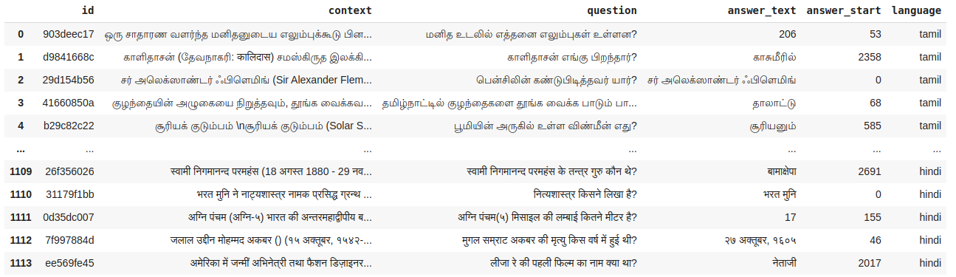
Train.csv
Size of train dataset is 1114 rows × 6 columns

Slide 5
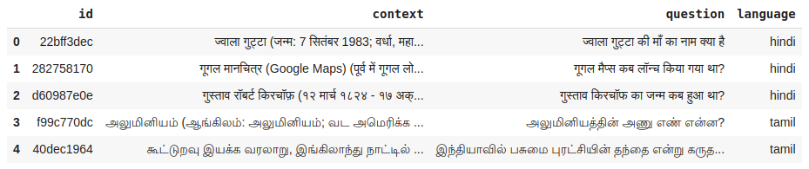
Test.csv
Size of test dataset is 5 rows × 4 columns
Original test set is kept private by Google.
While prediction we are expected to predict answer text only.

Slide 6
Our approach
IndicBert: We tried IndicBert for inference but we found it to be performing very poorly for the very task it was trained on i.e. Mask Language Modeling.
XLM-Roberta-Large: Authors train a Transformer based masked language model on one hundred languages, using more than two terabytes of filtered CommonCrawl data.
Inference model
Single Fold fine tuning
5 Fold fine tuning

Slide 7
Approach-1: Only Inference Pipeline
We used XLM-Roberta-Large that was fine tuned on SQuaD-2 dataset.
jaccard score - 0.571

Slide 8
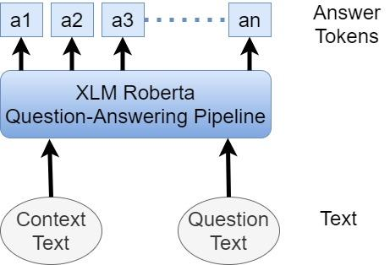
Architecture
Overall architecture of QA system that we are using.

Slide 9
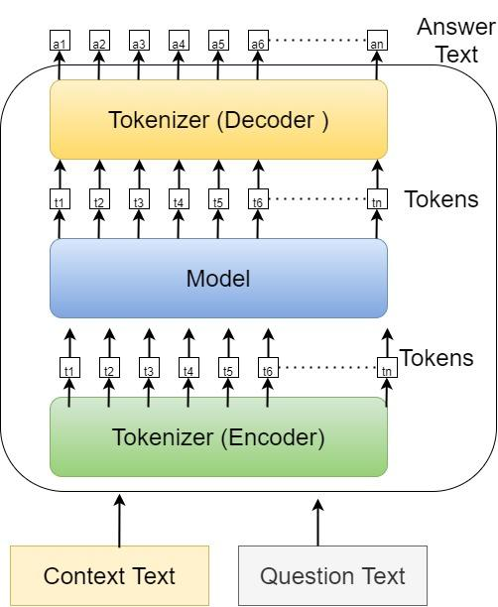
Architecture
Internal working of QA pipeline that we used in the inference model.

Slide 10
Approach-2: Single Fold Fine tuning
Approach:
We added 2 extra linear layers on top of XLMRoberta to output start and end position from set of tokens.
We fine-tuned our model on combined chaii-1 + MLQA dataset.
Maximum acceptable sequence length was 512 but in many cases, context length in our dataset was exceeding that limit.
Thus, context was split into n number of sub-parts, and instead of inputting one (context, question) pair, we input n such pairs.

Slide 11
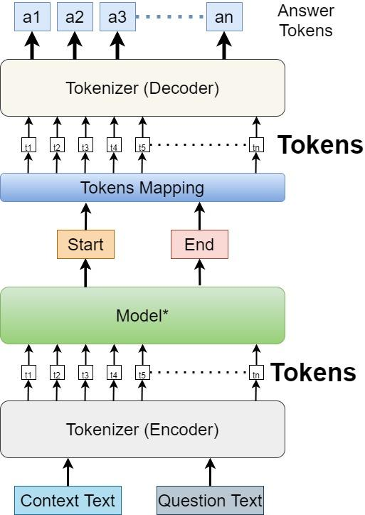
Architecture
Modified Pipeline of QA system
Model outputs start and end positions of answer.

Slide 12
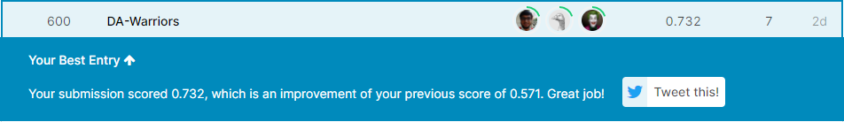
Leaderboard

Slide 13
Approach-3: Five Folds Fine tuning
Approach:
Everything remains the same except the training methodology.
Here, we use 5 folds training and at the end, we use ensemble learning to get the a combined output using all the folds.

Slide 14
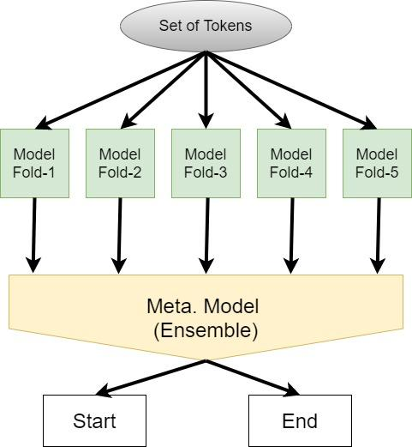
Architecture
In this approach, we train Meta model (ensamble) on the outputs of each fold.

Slide 15
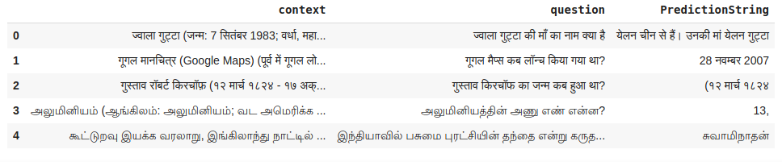
Sample Prediction results

